Slide 1
Introduction to Networks
CS487/587 Lecture
Department of Computer Science
Iowa State University

Slide 2
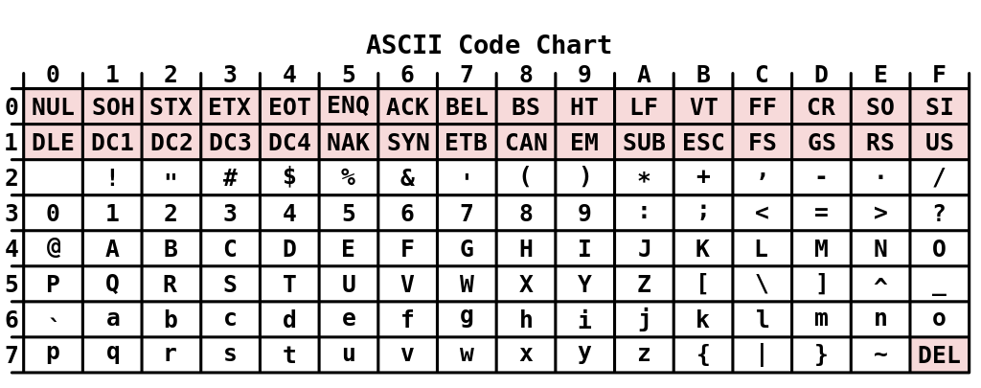
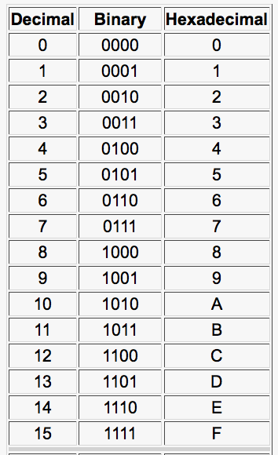
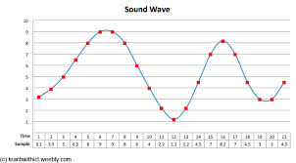

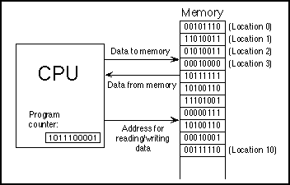
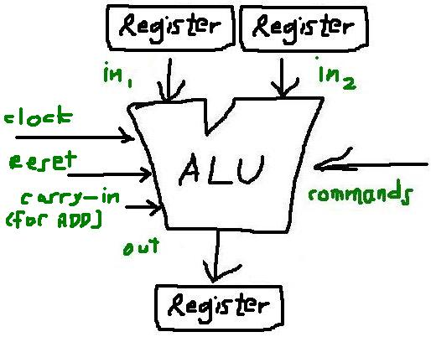
In the beginning, everything is 0 and 1

Slide 3
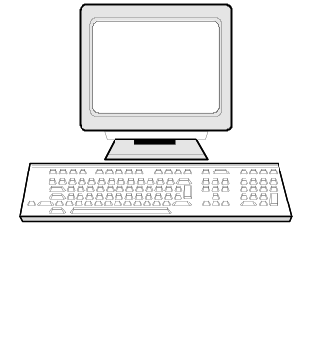
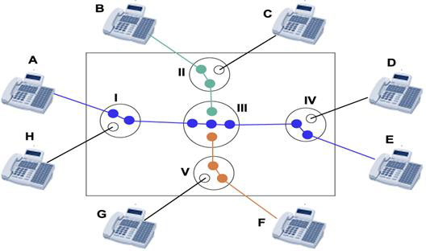
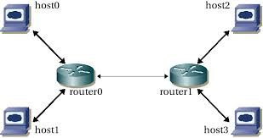
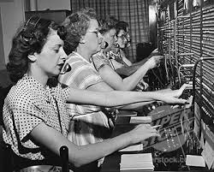
Network Basics
Communication Media
1/0
Circuit switching
manual or automatic
Dedicated end-to-end connection
Speed of light
Packet switching
Buffered, store and forward
Shared connection
delayed? Latency?
Protocol: Predefined formats (preexisting agreement) as to how to represent information, how to structure, how to send and receive, and how to interpret
Two machines must agree on a protocol before they can communicate
How does human learn and develop the protocols in communication?

Slide 4
Open Systems Interconnection (OSI) 7-Layer Model
Application
Application Layer
Presentation
Session
Transport
Transport Layer (TCP/UDP)
Network
5-Layer Model
Link
Physical

Slide 5
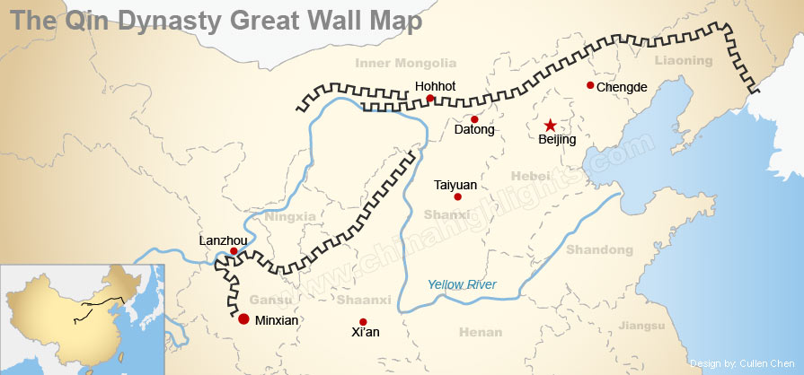
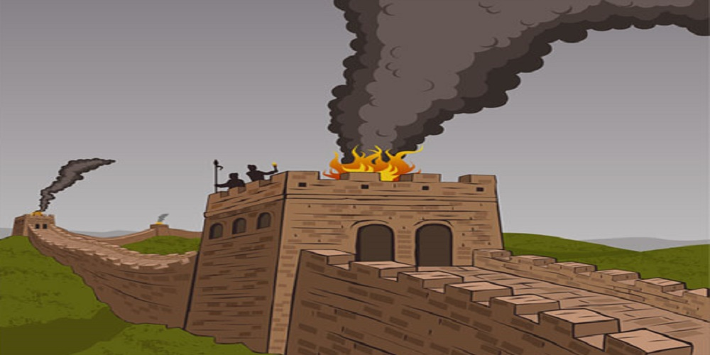
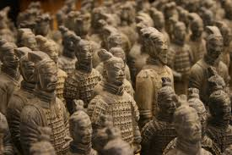
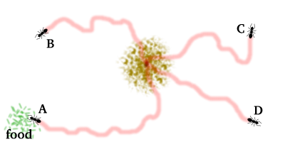

OSI 7-Layer Model
Application
Presentation
Session
Transport
Network
Link
Physical
Bit
  Communication media (copper, fiber, air, etc.)
  Signal processing (0/1 representation, speed, etc.)
Applications
  Beacon tower (fire)
  Other (sound, pheromone)
Transmission mode
  Simplex, half duplex, full duplex

Slide 6
OSI 7-Layer Model
Application
Presentation
Communication Media
Session
1101010...
Transport
Network
Link
Frame
  Typically contains a few hundreds of bytes
  Special mark for start and end of each frame
  Checksum error detections (or even correction)
  Erroneous frames can be discarded or retransmitted
  Medium access control (MAC): controlling how devices gain access to medium and permission to transmit data
Physical

Slide 7
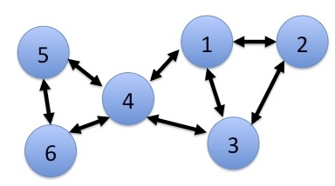
OSI 7-Layer Model
Application
Presentation
Session
Transport
Network
Packets, also known as datagram
  Packet routing and congestion control
Challenges of path finding
  Network heterogeneity
    e.g., from Ethernet to Token Ring to FDDI
  Multi-hop
    A data packet may have to go several hops before reaching its destination
  Multi-path
    The shortest route is not always the best route
    What really matters is the amount of delay on a given route
Link
Physical

Slide 8
OSI 7-Layer Model
Application
Presentation
Session
Transport
Network
Data stream
  Provide a virtual tunnel for end-to-end connection
Flow control
  Partition data into packets and assign each one a sequence number
  Provide service to assemble the received packets back into their original order
  Error detection and correction
Lowest layer to which application programs are typically written
Link
Physical

Slide 9
OSI 7-Layer Model
Application
Presentation
Session
Transport
Application-to-application data exchange
  Establishment
  Synchronization
  Re-establishment
Network
Link
Physical

Slide 10
OSI 7-Layer Model
Application
Presentation
Session
Data representation and conversion
  Character representation
    ASCII, UTF-8, or Unicode
  Integer representation
    Little/Big-endian, 32/64-bit
  Floating point representation
    IEEE 754, VAX
Data compression/decompression
Transport
Network
Link
Physical

Slide 11
OSI 7-Layer Model
Application
Presentation
Dictate the semantics of how requests for services are made, such as requesting a file or checking for email.
The container for all applications and protocols
  Telnet, HTTP, POP, SMTP, Finger, FTP, etc.
Virtually all distributed systems are applications
In Java, almost all network software written will be for applications.
Session
Transport
Network
Link
Physical

Slide 12
Quick Review
Application
Presentation
Session
Application to application
Transport
stream
Machine to machine
Network
packet
Direct/indirect
Link
frame
direct connection
Physical
bit
direct connection

Slide 13
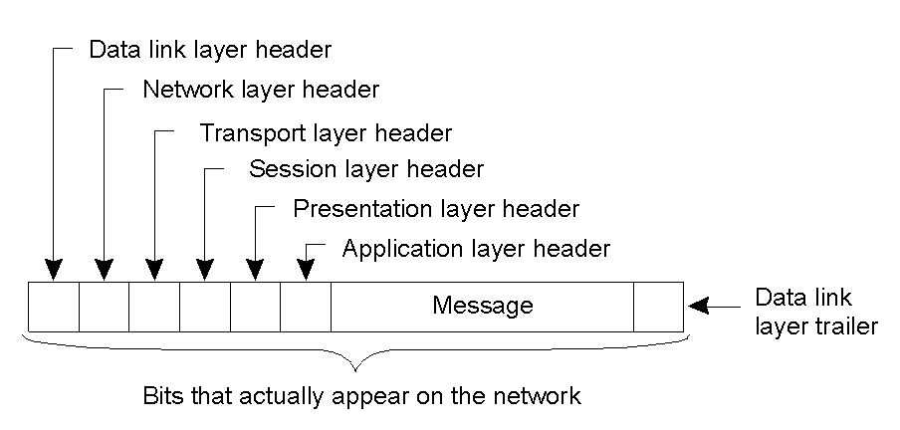
OSI 7-Layer Model
A typical message as it appears on the network.
2-2

Slide 14
Internet Protocol (IP)
An implementation of network layer
  Designed for packet-switched network
    Each packet contains no more than 64K bytes
  Connectionless
    Each packet is routed independently with sender and receiver address (what is the advantage?)
  Best-effort
    Packets could be discarded during transmission because of the exhaustion of resources or a failure at the data link or physical layer
  Unreliable
    Reliability is ensured at higher layer, such as TCP

Slide 15
0 1 3 4
0 1 2 3 4 5 6 7 8 9 A B C D E F 0 1 2 3 4 5 6 7 8 9 A B C D E F
+-+-+-+-+-+-+-+-+-+-+-+-+-+-+-+-+-+-+-+-+-+-+-+-+-+-+-+-+-+-+-+-+
|Version| HL |Type of Service| Total Length |
+-+-+-+-+-+-+-+-+-+-+-+-+-+-+-+-+-+-+-+-+-+-+-+-+-+-+-+-+-+-+-+-+
| Identification |Flags| Fragment Offset |
+-+-+-+-+-+-+-+-+-+-+-+-+-+-+-+-+-+-+-+-+-+-+-+-+-+-+-+-+-+-+-+-+
| Time to Live | Protocol | Header Checksum |
+-+-+-+-+-+-+-+-+-+-+-+-+-+-+-+-+-+-+-+-+-+-+-+-+-+-+-+-+-+-+-+-+
| Source Address |
+-+-+-+-+-+-+-+-+-+-+-+-+-+-+-+-+-+-+-+-+-+-+-+-+-+-+-+-+-+-+-+-+
| Destination Address |
+-+-+-+-+-+-+-+-+-+-+-+-+-+-+-+-+-+-+-+-+-+-+-+-+-+-+-+-+-+-+-+-+
| Options | Padding |
+-+-+-+-+-+-+-+-+-+-+-+-+-+-+-+-+-+-+-+-+-+-+-+-+-+-+-+-+-+-+-+-+
IP Header
Version: 4 bits
  helps smooth the transition to future version of IP
Header length: 4 bits
  specifies the length of the header, in multiples of 32 bits
  limits the header to 15 * 32bits = 60 bytes
Type of Service: 4 bits
  Specify a tradeoff between fast service and reliable service, not commonly used
Total length: 16 bits
  Length of packet, which is limited to 64K bytes
Time-To-Live (TTL): 8 bits
  limit the life of the packet on the network
    Initialized to thirty
    Decremented each time the packet arrives at a routing step
    Discarded when it is equal to 0
Identification (16 bits), Flags (3 bits), and Fragment Offset (13 bits)
  Partition a datagram into packet if it is too large
    Each packet must be no larger than 2^16 = 64K
    The maximum number of fragments per datagram is 2^13 = 8192
  Flags field controls whether these datagrams may be fragments
    If a gateway can support only smaller packets, fields marked “do not fragment” are discarded

Slide 16
User Datagram Protocol (UDP)
An implementation of transport layer on top of IP
Unreliable data transmission
  No guaranteed on delivery
  Packets could be received out of order
Add port identification numbers and payload checksum to IP
  Ports allow multiplexing of data streams
Highly efficient because of low overhead
  Suitable for delivering data that is small amount and needs to be sent frequently
  Typically used for latency-sensitive or low-overhead applications (video, time, DNS, etc.)

Slide 17
UDP Header
0 7 8 15 16 23 24 31
+--------+--------+--------+--------+
| Source | Destination |
| Port | Port |
+--------+--------+--------+--------+
| | |
| Length | Checksum |
+--------+--------+--------+--------+

Slide 18
Transmission Control Protocol (TCP)
An implementation of transport layer on top of IP
Reliable data transmission that can be used to send a sequence of bytes
  Provide guaranteed delivery and ordering of bytes, i.e., data are always received in their original order
Port numbers, like UDP
Checksums payload
Flow control
  Sensitive to packet loss and round-trip time
Error recovery: retransmit lost/corrupted packets

Slide 19
TCP Header
0 1 2 3
0 1 2 3 4 5 6 7 8 9 a b c d e f 0 1 2 3 4 5 6 7 8 9 a b c d e f
+-+-+-+-+-+-+-+-+-+-+-+-+-+-+-+-+-+-+-+-+-+-+-+-+-+-+-+-+-+-+-+-+
| Source Port | Destination Port |
+-+-+-+-+-+-+-+-+-+-+-+-+-+-+-+-+-+-+-+-+-+-+-+-+-+-+-+-+-+-+-+-+
| Sequence Number |
+-+-+-+-+-+-+-+-+-+-+-+-+-+-+-+-+-+-+-+-+-+-+-+-+-+-+-+-+-+-+-+-+
| Acknowledgment Number |
+-+-+-+-+-+-+-+-+-+-+-+-+-+-+-+-+-+-+-+-+-+-+-+-+-+-+-+-+-+-+-+-+
| Data | |U|A|E|R|S|F| |
| Offset| Reserved |R|C|O|S|Y|I| Window |
| | |G|K|L|T|N|N| |
+-+-+-+-+-+-+-+-+-+-+-+-+-+-+-+-+-+-+-+-+-+-+-+-+-+-+-+-+-+-+-+-+
| Checksum | Urgent Pointer |
+-+-+-+-+-+-+-+-+-+-+-+-+-+-+-+-+-+-+-+-+-+-+-+-+-+-+-+-+-+-+-+-+
| Options | Padding |
+-+-+-+-+-+-+-+-+-+-+-+-+-+-+-+-+-+-+-+-+-+-+-+-+-+-+-+-+-+-+-+-+
| data |
+-+-+-+-+-+-+-+-+-+-+-+-+-+-+-+-+-+-+-+-+-+-+-+-+-+-+-+-+-+-+-+-+

Slide 20
IP + TCP/UDP = INTERNET
Resource sharing between networks
  Information sharing
  Computing resource sharing
Hardware and software independence
  Interoperable with any CPU architecture, operating system, and network interface card
Reliability and robustness
  Data can be rerouted if necessary in order to reach its destination, regardless of the state of intermediary networks
Distributed management and control

Slide 21
Reading Material
https://en.wikipedia.org/wiki/OSI_model
https://en.wikipedia.org/wiki/Port_(computer_networking)

Slide 22
Review Questions
What pros and cons are for circuit switching and packet switching?
What are names of the 5/7 layers and their corresponding functionalities?
Which layer(s) deal with machine to machine communication?
Which layer(s) deal with application to application communication?
An IP packet can hold up to 64k bytes. Why?
Why the concept of port is significant? How many ports can a machine have? Why?
In your view, which layer is most challenging to implement? Why?

